Slide 1
SAGAR KALAUNI
2024 Analytics & Insight-Intern

Slide 2

ABC Analysis of Inventory
Goal: Conduct ABC analysis of inventory across Plant, Mine, and Lgnorth locations.
What my dashboard should look like?
Work more with DAX
Need for categorization
A Items – 70%
B Items – 20%
Annual Dollar Value per Unit (ADVU)
C Items – 10%
…?
Look other’s project
Main Heading
Slicer
Power BI function💡
Slicer
Slicer
Item no. | Total Issue | ADVU | Cum ADVU | % of total | Cum of % total | New category | Old category | Remark
1010 | 10 | $500 | $c | 0.5 | 6 | A | B | Changed
.
.
.
Dubbing hard
…
Will divide top 70% A….
Somehow calculate
cumulative
Coding Dax with math easy
Will rank them based on ADVU
Math 💡
New Category
Old Category
Change Count
Notes:
Plant, Mine & LGnorth

Slide 3
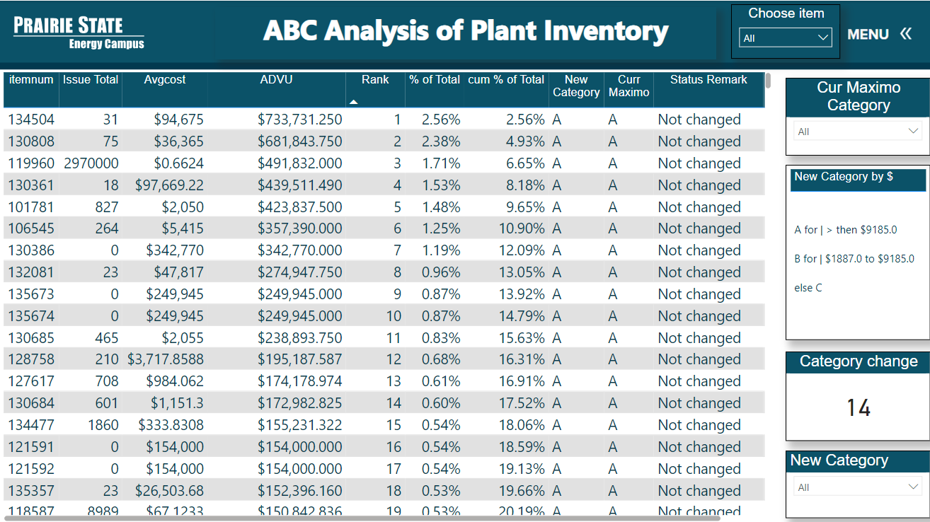
ABC Analysis of Plant Inventory
Drill Through

Slide 4

Special Thanks To:
Josh Hagene, Mackenzie Tabing, Jonathan Sander, Jeff Miller, Tom Foust Jr
Tyler Tiemann, Claire Beyes, Alyssa Lohmann
David Sohn, Dustin Wethen, Justin Gale
Randy Short and whole PSGC teams.

Slide 5


